Slide 1
Control Statements

Slide 2
Statements is an individual instruction of a program always end with a semicolon ( ; )
Control statements are used for controlling the execution of the program
They are classified into 3
Decision making statements
Iteration statement ( Looping statements )
Jump statements

Slide 3
Decision making statement
This statement execute at one time when a condition will be executed.
If
if else
Conditional operator
Nested if
else if ladder
switch

Slide 4
Looping statement / Iteration statement
Used to execute a block of statement at multiple times
while statement
do-while statement
for statement
2 types loops
Pre-test : loop condition appear at beginning. ( while, for )
Post-test : loop condition appear at the end of the loop ( do-while )

Slide 5
Jump statement
Used to transfer the program control with in a function unconditionally
goto
break
continue

Slide 6
Decision making Statements

Slide 7
If statement
Syntax :
if (condition)
{
// block of code to be executed if the condition is true
}
Decision making condition
Start
End

Slide 8
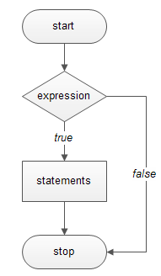
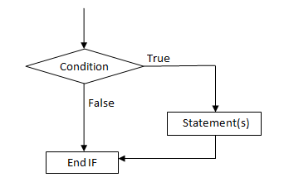

Slide 9
if (condition)
{
// statement part
}
Steps
Condition check
If it is true, the statement part executed.
If it is false the statement part does not executed

Slide 10
If-else statement
Syntax :
if (condition)
{
// block of code to be executed if the condition is true
}
else
{
// block of code to be executed if the condition is false
}
Decision making condition
Start
End
Start
End

Slide 11
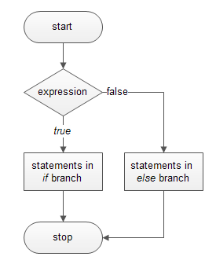
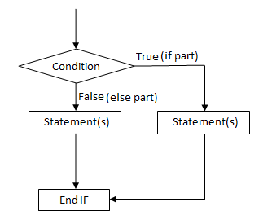

Slide 12
if (condition)
{
// statement 1
}
else
{
// statement 2
}
Steps
Condition check
If it is true, the statement 1 will be executed.
If it is false the statement 2 will be executed.

Slide 13
Conditional operator ( ? : )
It is a ternary operator
Same as if – else statement
Syntax :
Condition ? // true statement : // false statement

Slide 14
(condition) ? // statement 1 : // statement 2
Steps
Condition check
If it is true, the statement 1 will be executed.
If it is false the statement 2 will be executed.

Slide 15
Nested If statement
Syntax :
if (condition 1)
{
if (condition 2)
{
// block of code to be executed if the condition 1 and condition 2 are true
}
}

Slide 16
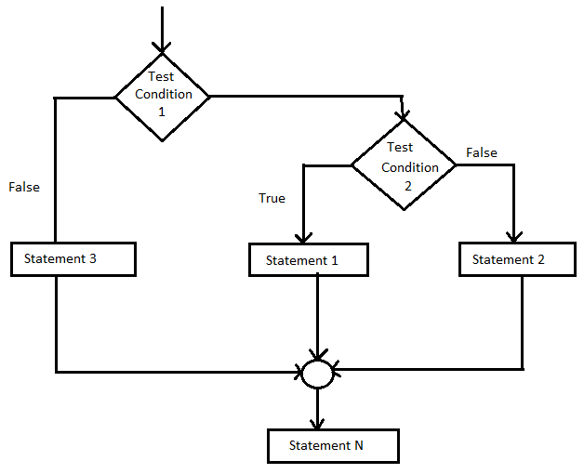
An if statement contain another if statement is called nested if
The statement is executed only
when both the codes are true

Slide 17
if (condition 1)
{
statements 1;
}
else if (condition 2)
{
statements 2;
}
else if (condition 3)
{
statements 3;
}
else
{
statements n;
}
else if ladder
A variable which has more than
two possibilities this statements are used
Act as a multiple branch statement
Syntax :

Slide 18
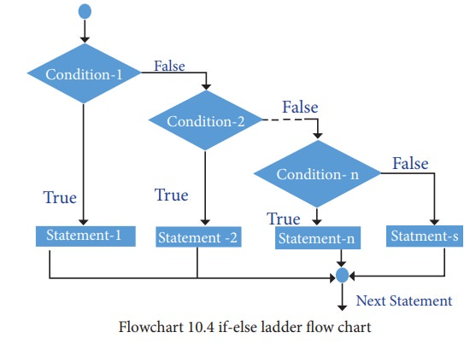

Slide 19
Switch statement
Re-arranged form of else-if ladder
It consist of
switch variable
Constant case values
Case statements
Break statement
And a default statement

Slide 20
Switch statement
Syntax :
switch (variable)
{
case value1 : statement 1; break;
case value2 : statement 2; break;
case value3 : statement 3; break;
default : default statement
}

Slide 21
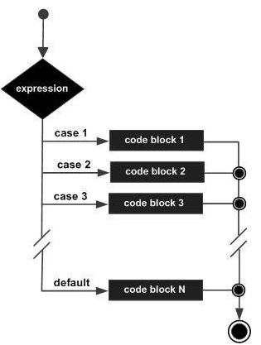

Slide 23
Iteration / Loop Statements

Slide 24
Looping statement / Iteration statement
Used to execute a block of statement at multiple times
while statement
do-while statement
for statement
2 types loops
Pre-test : loop condition appear at beginning. ( while, for )
Post-test : loop condition appear at the end of the loop ( do-while )

Slide 25
while loop
It is an entry controlled loop ( pre-test )
Syntax :
while (condition)
{
// block of code to be executed if the condition is true
}
Decision making condition
Start
End

Slide 26
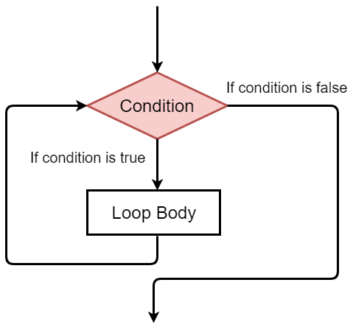

Slide 27
while (condition)
{
// statement part
}
Steps
Condition check
If it is true, the statement part executed.
Repeat the statement part.
Exit from the loop whenever the condition goes to fault state

Slide 28
for loop
It is an entry controlled loop ( pre-test )
For loop is a repetition control statement.
Syntax :
for (initialization ; condition ; update)
{
// body of the for loop
}
Start
End

Slide 29
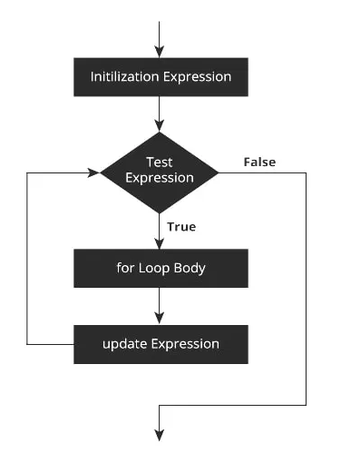

Slide 30
for (initialization ; condition ; update)
{
// body of the for loop
}
Steps
Initiate the variable
Check the condition
If it is true, execute the body part at onetime.
Update the variable by 1
Again check the condition, and repeat the step until the condition is false

Slide 31
do-while loop
It is an exit controlled loop ( post-test )
The statement will be executed at ones without depending the condition
Syntax :
do
{
// body of the for loop
} (condition);
Start
End

Slide 32
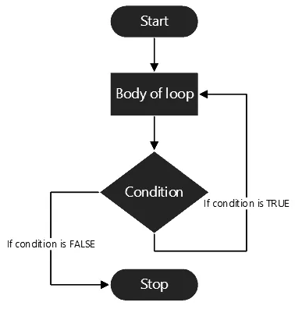

Slide 33
do
{
// body of the for loop
} (condition);
Steps
Execute the body part at ones
Check the condition
If it is true, repeat the loop
If it is false, end the loop

Slide 35
Jump Statements

Slide 36
Jump statement
Used to transfer the program control with in a function unconditionally
goto
break
continue

Slide 37
goto
Can be used any ware in the program
It transfer the control from one part to another part of the program without any condition
A goto statement can be do both forward and backward reference
Syntax :
goto label ;

Slide 38
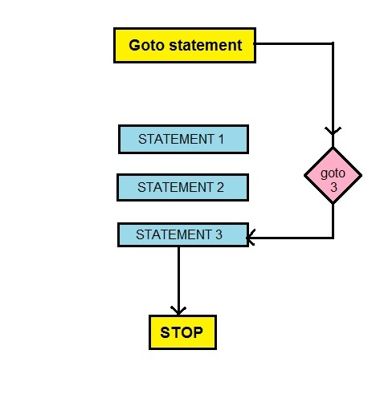

Slide 39
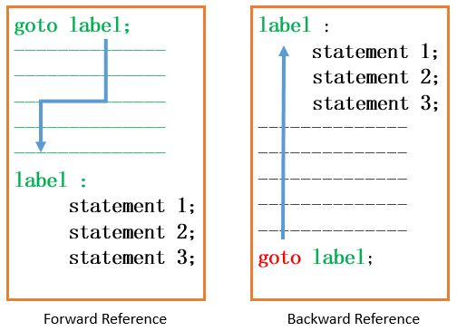

Slide 40
Break
used in loop and switch statements
It is used to exit immediately from a loop or switch statement
It can be used to end an infinite loop
Syntax :
break ;

Slide 41
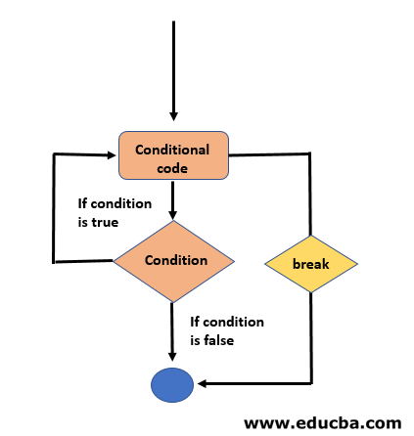

Slide 42
continue
It is used to continue a program immediately
Also used to skip the iteration of loop
Opposite action of break statement
Syntax :
continue ;

Slide 43
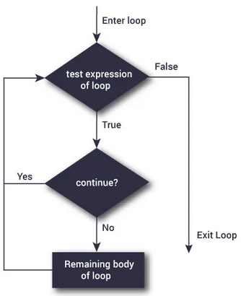

Slide 44
Teaching materials Prepared by
RIDHUN DEV
Lecture IHRD College
+1 / +2 Computer Science
8089552581

